Slide 1


Instructions for Records Retention Disposition Form
Disposal Application Process using Adobe Sign electronic signature
June 2019

Slide 2
Disposal Application Process using Adobe Sign
Agency sends completed unsigned Disposal Application form to DORIS, with completed cover sheet (page 1) and completed list of record series for disposal (page 2).
  Disposal application is online
    https://www1.nyc.gov/assets/records/pdf/2019-01-11%20DORIS%20Disposal%20Application.pdf
DORIS sends the Agency an Adobe Sign link to sign the disposal application electronically.
  RMO approves the application
  Agency Head signs the application

Slide 3
Disposal Application Process using Adobe Sign
The Agency Head signs using Adobe Sign and the program sends an email to the Law Department and the Municipal Archives simultaneously letting them know the disposal application is ready for review.
The Law Department and Municipal Archives review and electronically sign the disposal application. It will then be re-routed back to the MRMD.
DORIS Commissioner reviews application, either approves or disapproves and returns application to the MRMD.
DORIS informs the Agency of the status of the disposal application.

Slide 4
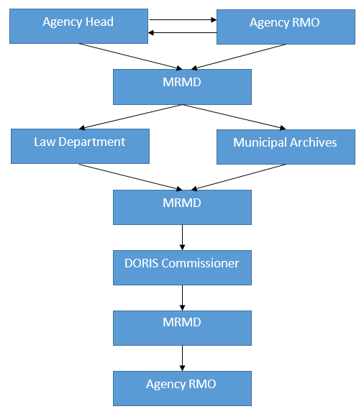
Overview of Disposal Process Workflow

Slide 5
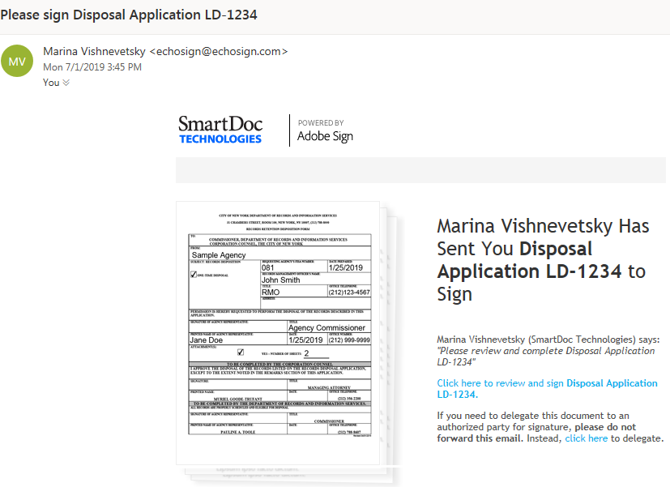
Adobe Sign Email Link

Slide 6

RMO approves the application by scrolling down and clicking approval.

Slide 7
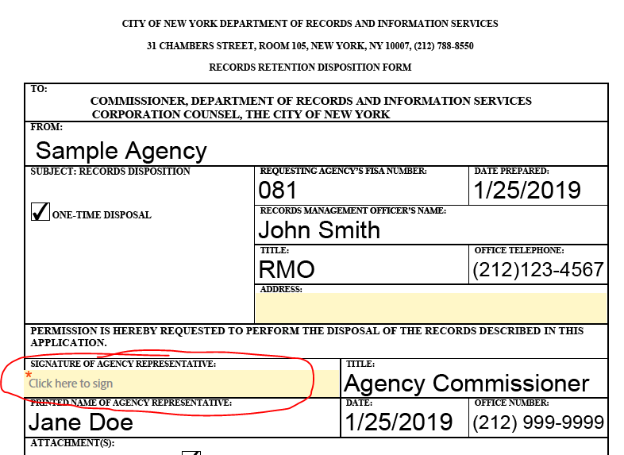
Agency Head electronically Signs the Summary Page
Sign here

Slide 8
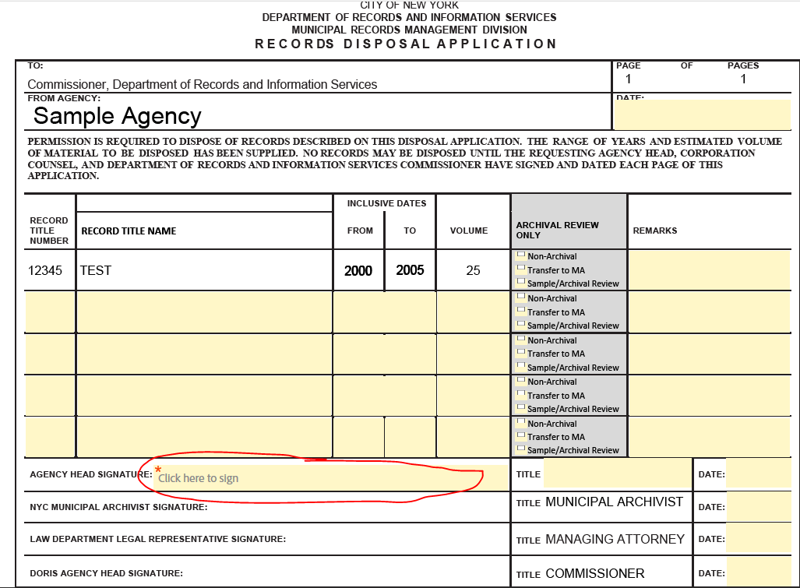
Agency Head electronically Signs the Detail Page
Sign here

